Slide 1
Prototype Pattern

Slide 2
Prototype Pattern
A creational design pattern that lets you produce new objects by copying existing ones without compromising their internals.

Slide 3
Intent
Use a prototype object instance for creating new objects, by copying the prototype
Constructing a new object from zero takes a lot of time an effort
Move contruction logic away from the calling code

Slide 4
Benefits
Ideal of construction process occurs in a number of discrete steps
It’s much faster to initialize the prototype once and then copy the prototype in memory each time you need a new object

Slide 5
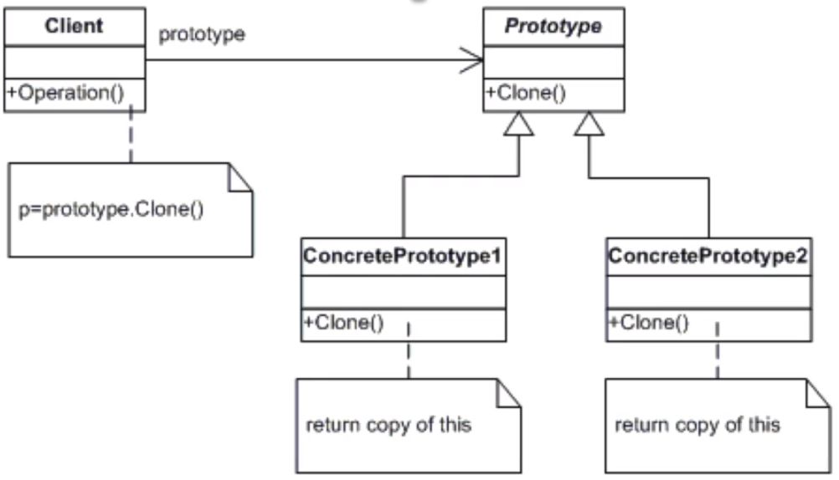
UML

Slide 6
How to implement
Create the prototype interface and declare the clone method in it. You may simply add the method to all classes of existing class hierarchy, if you have one.
Add an alternative constructor to all prototype classes, which accepts an object of a current class. The constructor must copy values of all fields defined in the class from the passed object to the current instance. Then it should call the parent constructor to take care of superclass fields. If your programming language does not support method overloading, you may define a special method for copying the data. The constructor is just more convenient since it delivers the copy right after using the new operator.
The clone method usually consists of just one line: running a new operator using the prototype constructor. Note, that each class that supports cloning must explicitly override the clone method to use its class name along the new operator. Otherwise, cloning will produce an object of a parent class.
Optionally, create a centralized prototype registry to store the catalog of frequently used prototypes. It may even store objects of the same class, configured in different ways.

Slide 7
Checklist
Make sure your objects have a complex multi-step initialization code and that they’re all derived from the same generic template
Create an abstract prototype that declares a Clone Method
Create concrete prototypes that implement the Clone method
Add a client class that initializes objects by starting with a cloned prototype
Make sure the calling code does not use new anywhere and only uses the client to create new instances

Slide 8
Comments
In a shallow copy all value types and references are copied. In a deep copy all of the objects that the reference types refer to are also copied.
A very quick and easy way to create a deep copy is to serialize the prototype into a memory stream and deserialize it back into a clone.

Slide 9
Applicability
When your code should not depend on the concrete classes of objects that you need to copy. For examples, when objects' classes are unknown since you work with them via an interface.
The Prototype pattern provides a client an interface to work with all prototypes. This interface is common for all objects that support cloning. It makes client code independent from concrete classes of products that it clones.
When you want to reduce the size of a class hierarchy that consists of similar objects, configured in different ways (in other words, each class would have unique field values).
The Prototype pattern allows creating a set of prototype objects that represent all possible configurations of an object.
Then, instead of instantiating a subclass that matches some configuration, client code looks for the appropriate prototype and clones it.

